Slide 1
Project Presentation
Team Members
Shiqi Lu
Jiawei Wang
Jinling Yang
Felix Adigbli

Slide 2
TimeToMaster
Description:
We developed a habit-formation web application that helps users establish and track their personal habits. The application provide a user-friendly interface that allows users to create and manage habit lists, record and track their progress, and monitor habit execution. Users will be able to set goals, receive reminders, and gain visual feedback on their habit-formation journey

Slide 3
Project Features
1). Account:
user can be able to create and delete an account
user can be able to view and edit their personal info
user can be able to login and logout
2). Goal:
user can be able to create, update, view and delete a habit/goal
user can be able to view statistics in Chart/Graph
3). Achievement:
user can be able to fetch all / update (a) achievements
user can aquire one achievement when finish a goal

Slide 4
Supported Design
Basic CRUD operations
Expressjs and Mongo
Backend Code Documentation
Muitiple UI Routes
Restful API Design
UI Code Documentation
UI Component Design
Domain Driven Design
UX Design

Slide 5
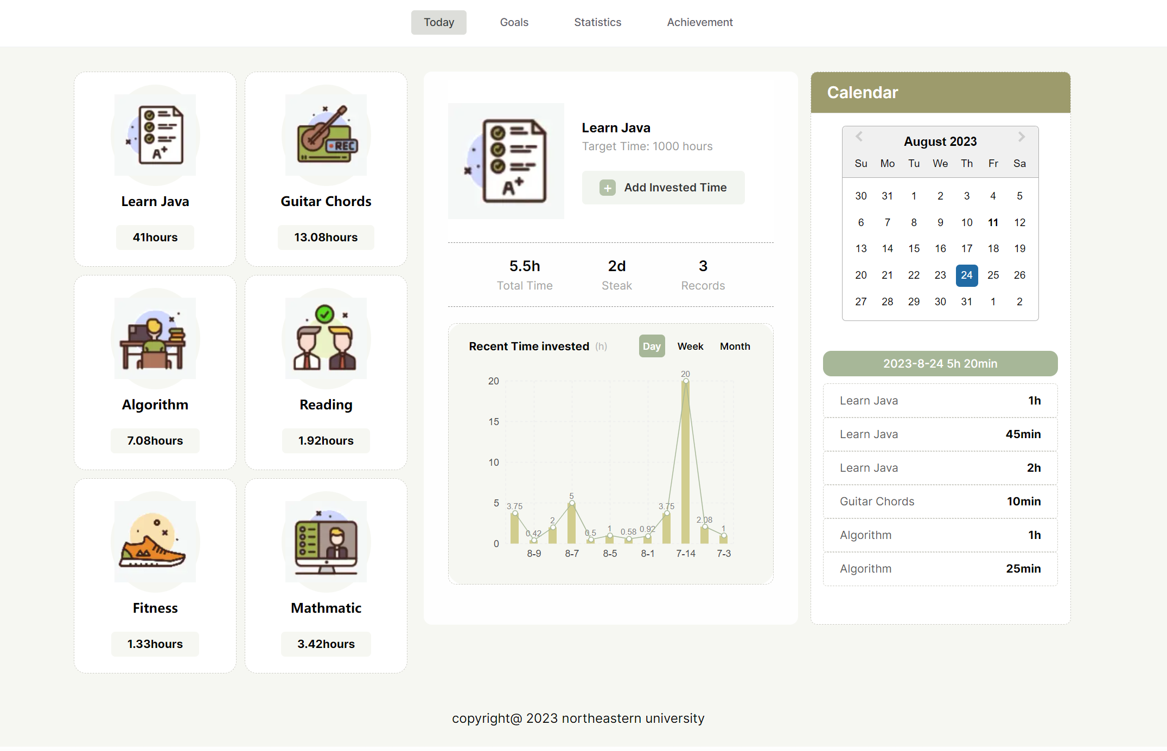
Project Screenshots

Slide 6
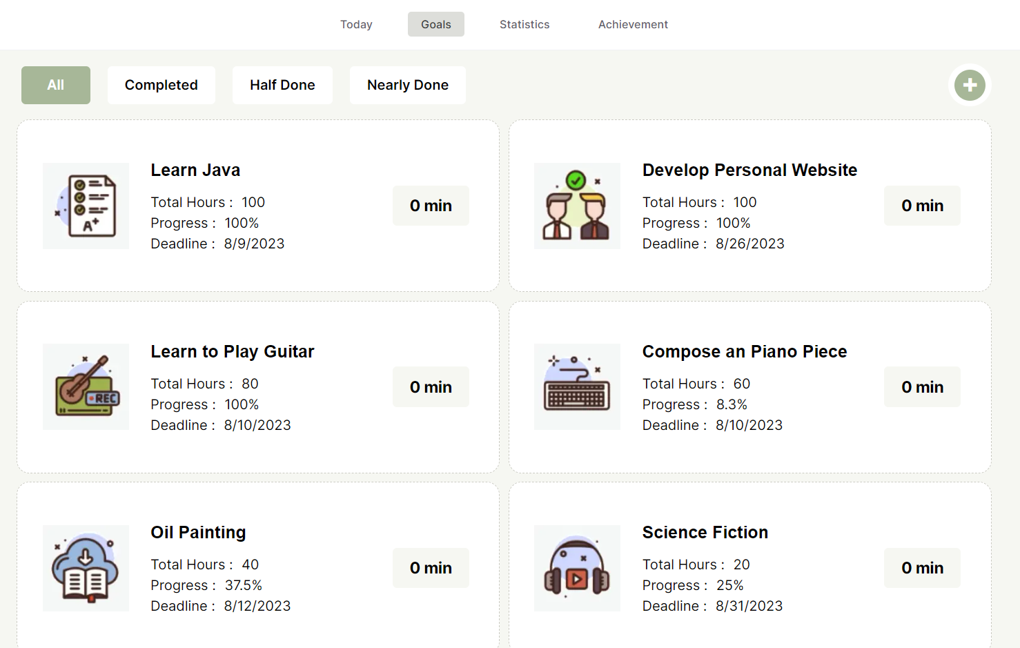
Project Screenshots

Slide 7
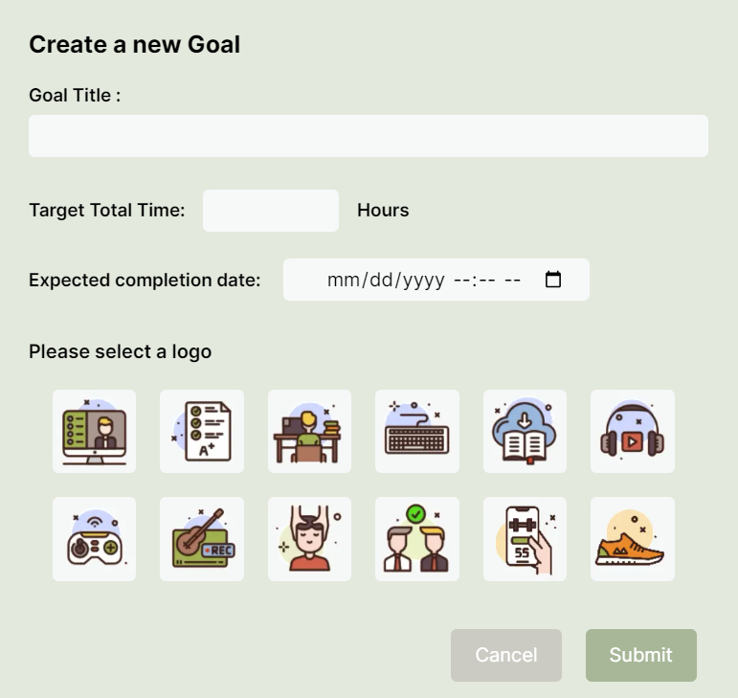
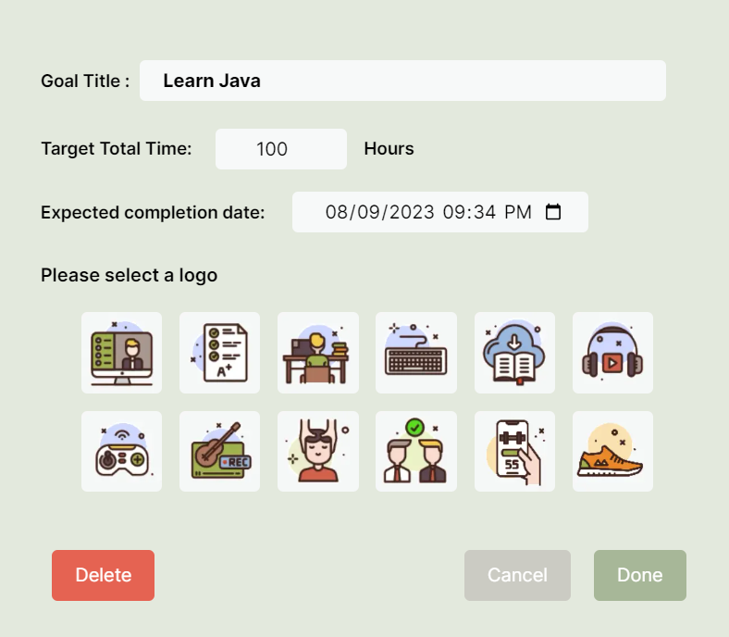
Project Screenshots

Slide 8
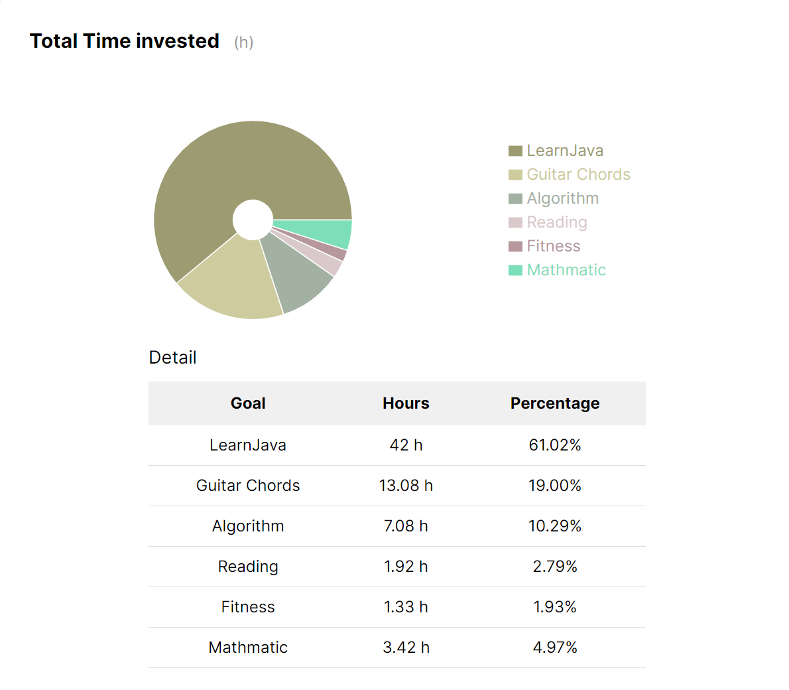
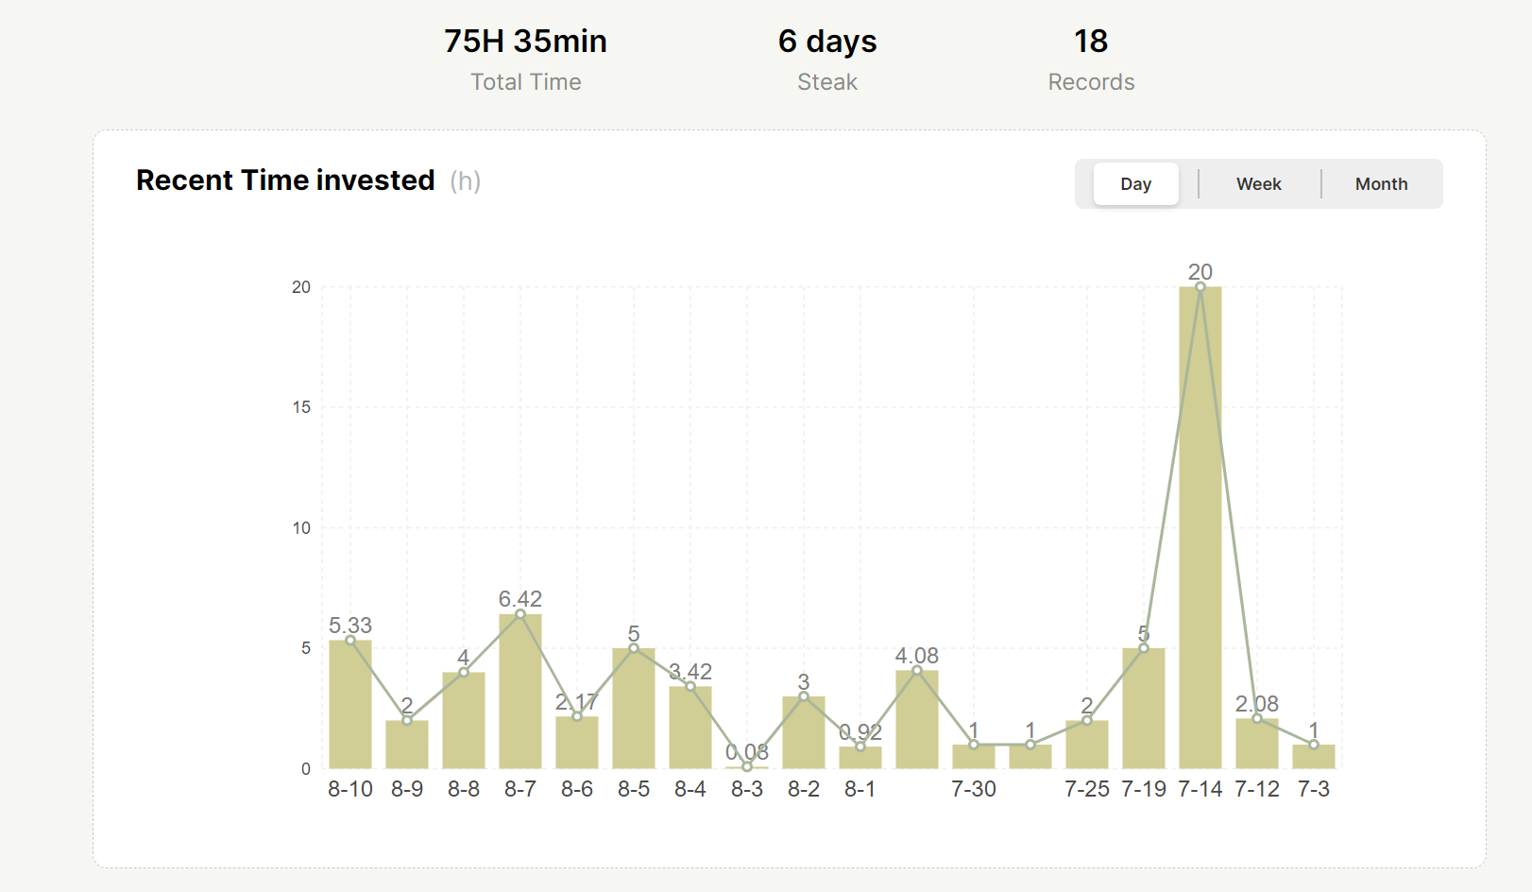
Project Screenshots

Slide 9
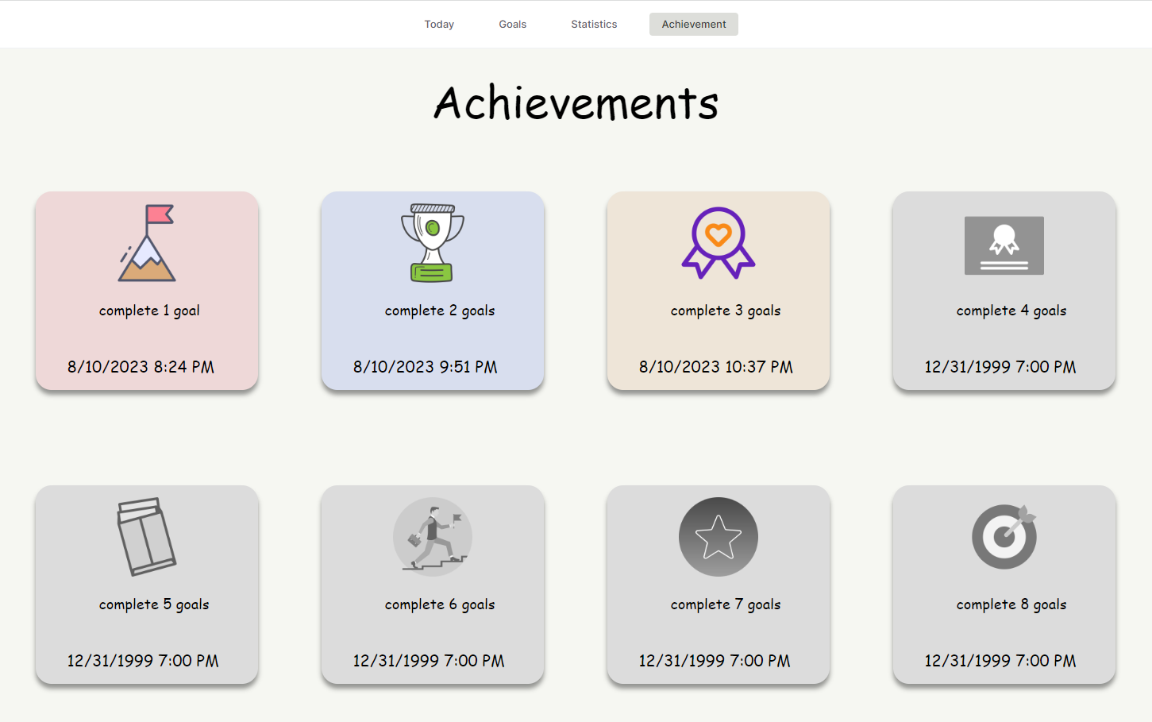
Project Screenshots

